Slide 1

Global Partners – Q1 2024 Business Intelligence Report
Customer Orders, Performance & Regional Insights
Selvin Tuscano

Slide 2
Introduction
Executive Summary
Sales & Profit Trends
Agenda
Category Performance
Regional Performance
Customer Segmentation & Loyalty
Customer Performance
Management Accountabilty
Recommendations

Slide 3
Introduction
This report provides a comprehensive business intelligence review of Global Partners’ performance in Q1 2024, based on Tableau dashboards.
The analysis covers:
Overall performance KPIs (Sales, Profit, Customers, Orders).
Sales & profit trends over time.
Product category and regional performance.
Customer segmentation, loyalty, and top customer insights.
Management accountability in driving sales outcomes.
Objective:
To convert raw performance data into actionable insights that support decision-making on growth opportunities, risk areas, and strategic priorities.
Global Partners | Confidential Information | For Internal use only

Slide 4
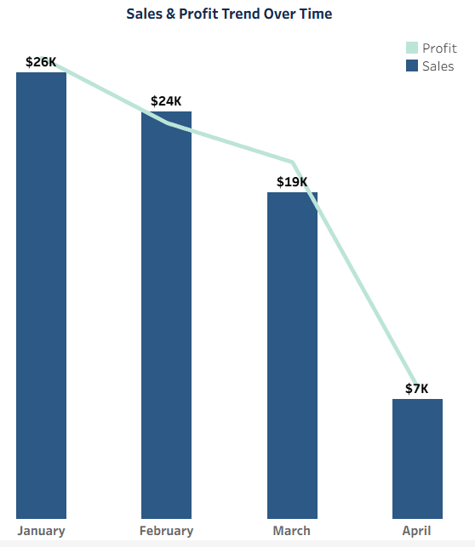
Executive Summary 2024 - QTR 1
Support it with a brief explanation.
Key metrics
Key trends
Sales steadily declined from $26K in January → $7K in April, showing early demand risks.
Despite revenue drop, margins improved in March (16.97%), reflecting operational efficiency.
Q1 started volume-strong, but demand has clearly softened over time.
Global Partners | Confidential Information | For Internal use only

Slide 5
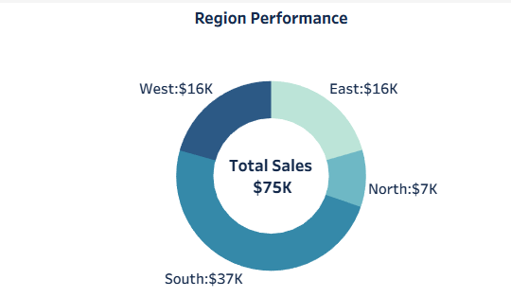
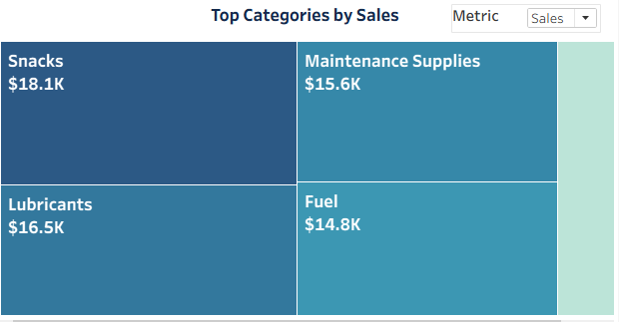
Category Insights and Regional Insights
Category Insights
Regional Insights
Snacks ($18K) → Largest share, volume growth driver.
Lubricants ($16.5K) & Fuel ($14.8K) → Smaller in volume but high margin contributors.
Maintenance Supplies ($15.6K) → Stable, steady contributor.
Beverages ($4K) → Consistent but limited growth.
South ($37K) → Dominates with ~50% of total sales.
West & East (each $16K) → Mid-tier regions.
North ($7K) → Weakest, requires focus.
Global Partners | Confidential Information | For Internal use only

Slide 6
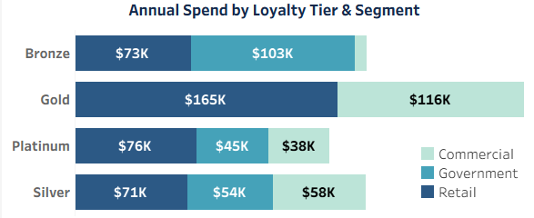
Customer Segmentation & Loyalty
Loyalty Tier Analysis:
Gold customers: $281K spend across segments (anchor customers).
Silver customers: ~$130K combined, strong base for upgrades.
Platinum: Smaller base but steady contribution.
Bronze: Lowest contribution ($73K), but growth potential.
Global Partners | Confidential Information | For Internal use only

Slide 7
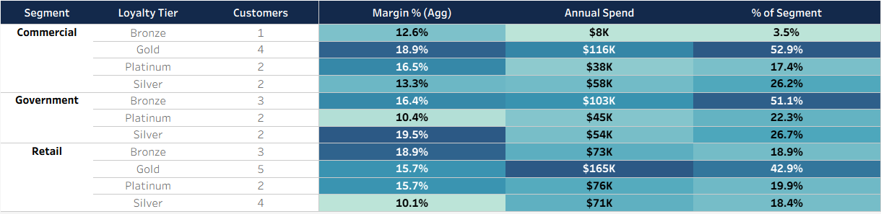
Customer Segmentation & Loyalty
Segment × Loyalty insights:
Commercial Gold = 52.9% of segment spend → key segment to defend.
Retail Gold = 42.9% of spend → strong, growing base.
Global Partners | Confidential Information | For Internal use only

Slide 8
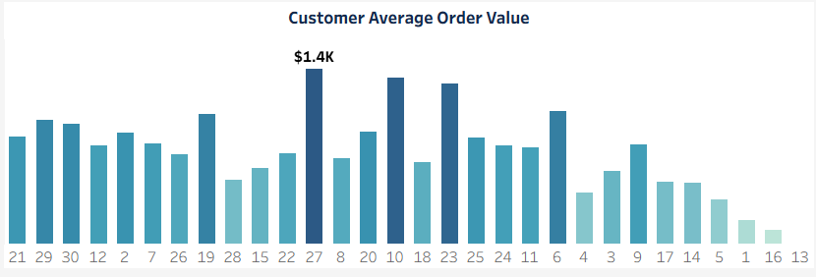
Customer Performance
Key Highlights
Insights
Business is highly dependent on a few key accounts → retention risk.
Growth potential in long-tail customers through upselling and cross-selling.
Strategy: Protect top accounts while lifting mid-tier customers to balance revenue.
Top 5 customers contribute $4.3K–$5K each, showing a concentrated revenue base.
Average order value peaks at $1.4K, but most customers spend below $1K.
Revenue is top-heavy, with many customers contributing only small amounts.
Global Partners | Confidential Information | For Internal use only

Slide 9
Management Accountability
Back to Agenda Page
VP-wise sales contribution:
Peter’s team: Drives most sales, but uneven across managers (Anthony, Keenan, Kim, Brittney).
Kumar’s team: Moderate contribution, Jon drives more than Xiom.
Sheela’s team: Consistent but smaller base (Gram, Rake).
Heavy dependence on Peter’s team poses concentration risk if key managers underperform.
Jon (under Kumar) and Kim (under Peter) stand out as strong performers.
Variability across managers shows the need for:
Performance coaching.
Balanced pipeline building across all VPs.
Knowledge-sharing from top performers to weaker teams.
Insights
Global Partners | Confidential Information | For Internal use only

Slide 10

Recommendations & Next Steps
Short-term actions:
Investigate April decline – demand issue vs. operational issue.
Double down on Snacks (volume) & Lubricants/Fuel (profit).
Run regional campaigns in North/East to balance growth.
Long-term actions:
Strengthen loyalty program → focus on converting Silver → Gold.
Develop management accountability frameworks – even distribution of performance.
Optimize product mix → defend high-margin categories while scaling top sellers.
Global Partners | Confidential Information | For Internal use only

Slide 11
Thank you!

